Slide 1


Training:
INVIDA – Dashboard
Audience: Internal Teams
Start here:
Add / Edit / Remove gauges

Slide 2
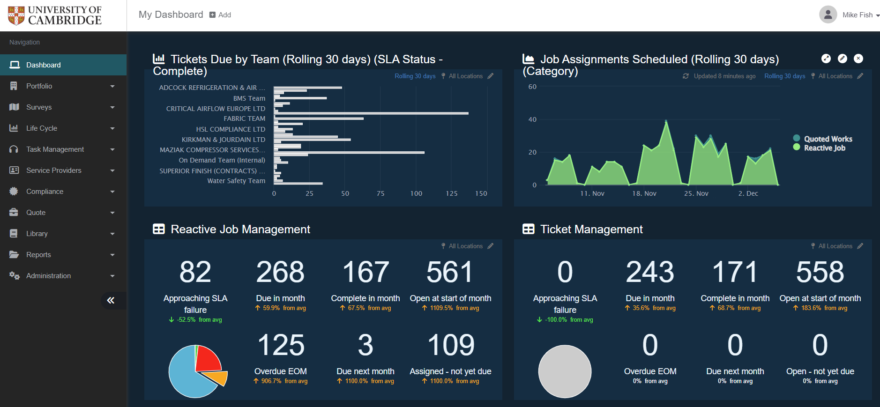
Add / edit gauges
Add new gauge
Update
Expand
Edit
Remove
Navigate to Dashboard
Next slide:
Gauges type menus

Slide 3
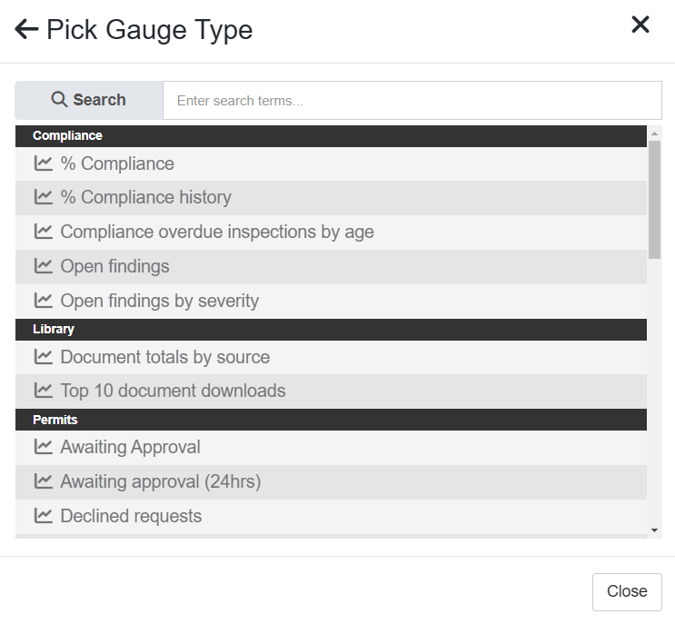
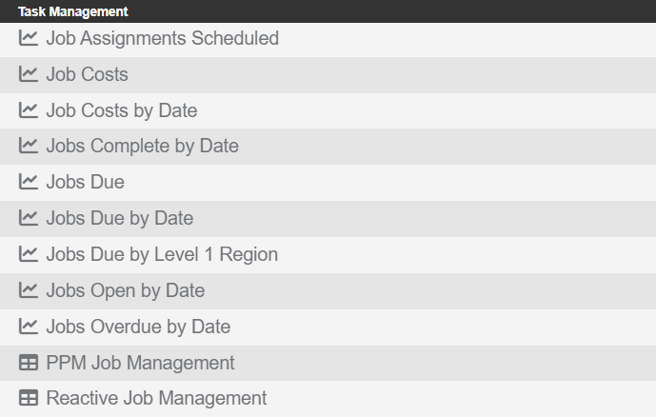
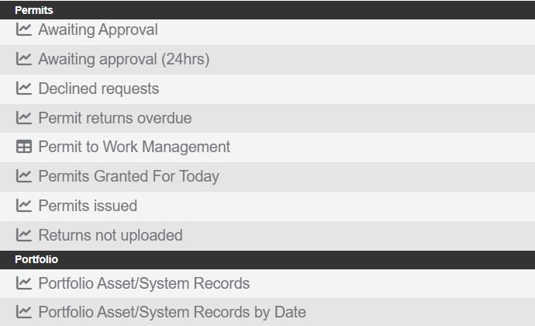
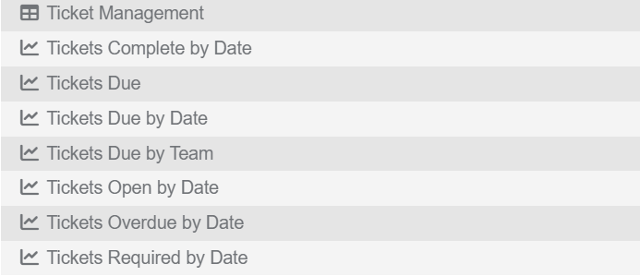
Gauge type menus
Compliance
Gauges
Jobs
Gauges
Library
Gauges
Not yet available
Not yet available
Not yet available
Permits
Gauge (N/A)
Not yet available
Not yet available
Tickets
Gauges
Not yet available
Not yet available
Not yet available
Not available
Back to:
Add / Edit /
Remove gauges
Portfolio
Gauges
Not available
Not available

Slide 4
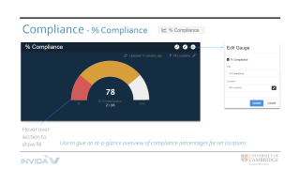
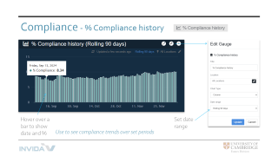
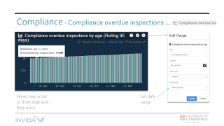
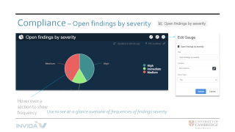
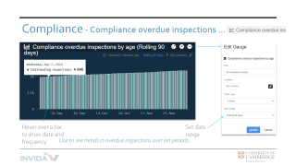
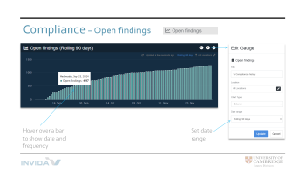
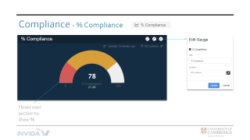
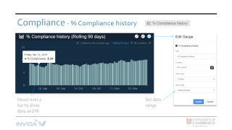
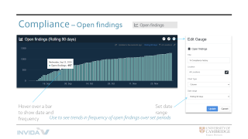
Compliance gauges
Click on images below to zoom in / out
Use to give an at-a-glance overview of compliance percentages for set locations
Use to see trends in overdue inspections
over set periods
Use to see compliance trends over set periods
Use to see trends in frequency of open findings
over set periods
Use to see at-a-glance overview of frequences of findings severity
Return to Menu

Slide 5
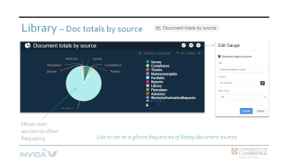
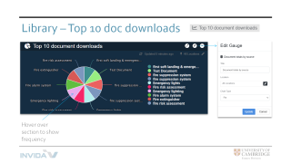
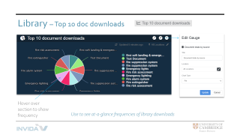
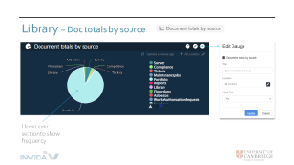
Library gauges
Click on images below to zoom in / out
Use to see at-a-glance frequencies of library document sources
Use to see at-a-glance frequencies of library downloads
Return to Menu

Slide 6
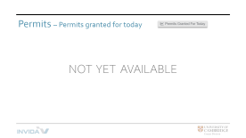
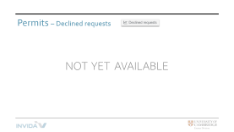
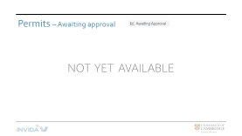
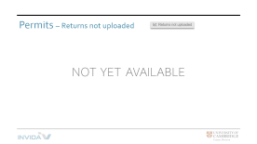
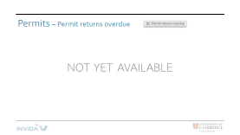
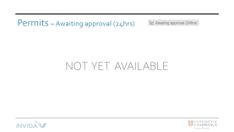
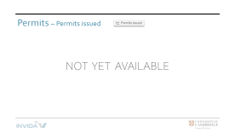
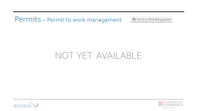
Permits gauges
Click on images below to zoom in / out
Return to Menu

Slide 7
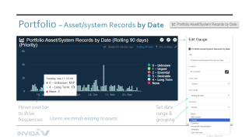
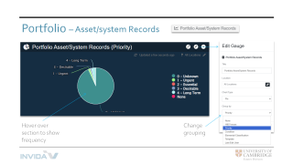
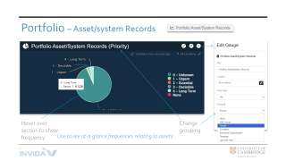
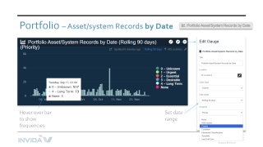
Portfolio gauges
Click on images below to zoom in / out
Use to see at-a-glance frequencies relating to assets
Use to see trends relating to assets
Return to Menu

Slide 8
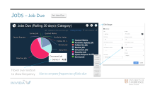
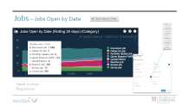
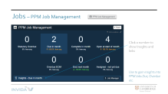
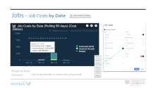
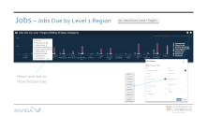
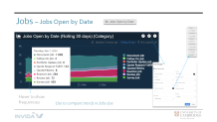
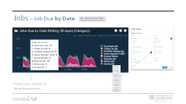
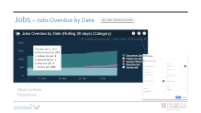
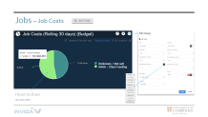
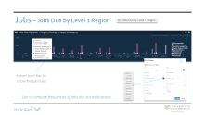
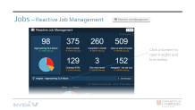


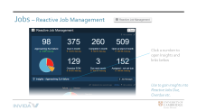
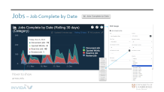

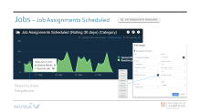
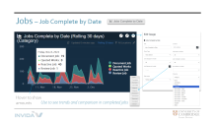

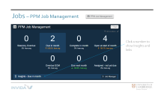

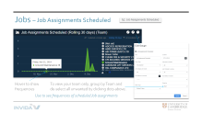
Jobs gauges
Click on images below to zoom in / out
Use to see frequencies of scheduled Job assignments
Use to see comparison of costs
Use to see trends and comparisons in completed Jobs
Use to see trends in cost over set periods
Use to compare frequencies of Jobs due
Use to compare trends in Jobs due
Use to compare frequencies of Jobs due across locations
Use to see trends in Jobs due
Use to compare trends in overdue Jobs
Use to gain insights into PPM Jobs due, overdue etc.
Use to gain insights into Reactive Jobs due, overdue etc.
Return to Menu

Slide 9

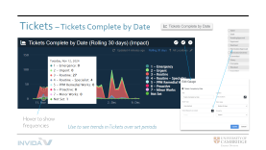
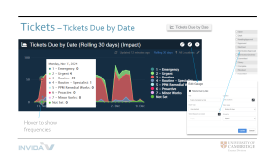
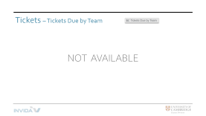









Tickets gauges
Click on images below to zoom in / out
Use to see trends in Tickets over set periods
Use to see frequencies of Tickets within a set period
Use to see trends in Tickets due over a set period
Use to gain insights into Tickets Open, Complete etc.
Use to see trends in Tickets open over a set period
Return to Menu

Slide 11


Compliance - % Compliance
Hover over section to show %
Use to give an at-a-glance overview of compliance percentages for set locations

Slide 12



Compliance - % Compliance history
Hover over a bar to show date and %
Set date range
Use to see compliance trends over set periods

Slide 13



Compliance - Compliance overdue inspections …
Hover over a bar to show date and frequency
Set date range
Use to see trends in overdue inspections over set periods

Slide 14


Compliance – Open findings
Hover over a bar to show date and frequency
Set date range
Use to see trends in frequency of open findings over set periods

Slide 15


Compliance – Open findings by severity
Hover over a section to show frequency
Use to see at-a-glance overview of frequencies of findings severity

Slide 16


Library – Doc totals by source
Hover over section to show frequency
Use to see at-a-glance frequencies of library document sources

Slide 17

Library – Top 10 doc downloads
Hover over section to show frequency
Use to see at-a-glance frequencies of library downloads

Slide 18
Permits – Awaiting approval
NOT YET AVAILABLE

Slide 19
Permits – Awaiting approval (24hrs)
NOT YET AVAILABLE

Slide 20
Permits – Declined requests
NOT YET AVAILABLE

Slide 21
Permits – Permit returns overdue
NOT YET AVAILABLE

Slide 22
Permits – Permit to work management
NOT YET AVAILABLE

Slide 23
Permits – Permits granted for today
NOT YET AVAILABLE

Slide 24
Permits – Permits issued
NOT YET AVAILABLE

Slide 25
Permits – Returns not uploaded
NOT YET AVAILABLE

Slide 26




Portfolio – Asset/system Records
Hover over section to show frequency
Change grouping
Use to see at-a-glance frequencies relating to assets

Slide 27


Portfolio – Asset/system Records by Date
Hover over bar to show frequencies
Set date range & grouping
Use to see trends relating to assets

Slide 28


Jobs – Job Assignments Scheduled
Hover to show frequencies
To view your team only, group by Team and de-select all unwanted by clicking dots above.
Use to see frequencies of scheduled Job assignments

Slide 29




Jobs – Job Costs
Hover to show amounts
Use to see comparison of costs

Slide 30



Jobs – Job Costs by Date
Hover to show amounts
Use to see trends in costs over set periods

Slide 31



Jobs – Job Complete by Date
Hover to show amounts
Use to see trends and comparison in completed jobs

Slide 32



Jobs – Job Due
Hover over section to show frequency
Use to compare frequencies of Jobs due

Slide 33


Jobs – Job Due by Date
Hover over section to show frequencies
Use to compare trends in Jobs due

Slide 34


Jobs – Jobs Due by Level 1 Region
Hover over bar to show frequencies
Use to compare frequencies of Jobs due across locations

Slide 35


Jobs – Jobs Open by Date
Hover to show frequencies
Use to compare trends in Jobs due

Slide 36


Jobs – Jobs Overdue by Date
Hover to show frequencies
Use to compare trends in overdue Jobs

Slide 37

Jobs – PPM Job Management
Click a number to show Insights and links
Use to gain insights into PPM Jobs Due, Overdue etc.

Slide 38

Jobs – Reactive Job Management
Click a number to open Insights and links below
Use to gain insights into Reactive Jobs Due, Overdue etc.

Slide 39

Tickets – Ticket Management
Click a number to open Insights and links
Use to gain insights into Tickets Open, Complete etc.
Note: Tickets do not have SLAs attached; therefore, no data re Approaching Failure, Overdue etc.

Slide 40



Tickets – Tickets Complete by Date
Hover to show frequencies
Use to see trends in Tickets over set periods

Slide 41


Tickets – Tickets Due
Hover to show frequencies
Use to see frequencies of Tickets within a set period

Slide 42


Tickets – Tickets Due by Date
Hover to show frequencies
Use to see trends in Tickets due over a set period

Slide 43
Tickets – Tickets Due by Team
NOT AVAILABLE

Slide 44


Tickets – Tickets Open by Date
Hover to show frequencies
Use to see trends in Tickets open over a set period

Slide 45
Tickets – Tickets Overdue by Date
NOT AVAILABLE

Slide 46
Tickets – Tickets Required by Date
NOT AVAILABLE

